Slide 1
Introducing Our New Learning Management System
Welcome to our new LMS! This presentation will provide an overview of its features and benefits.
What is an LMS?
Centralized platform for education
Manages learning content and activities
Facilitates communication and assessment
This LMS is being developed to enhance the learning experience and streamline administrative tasks for our entire community.
Students
Staff
Administrators
Access courses, submit assignments, track progress
Manage courses, grade submissions, communicate with students
Oversee system, manage users, analyze data

Slide 2
System Roles and Access
Role
Responsibilities
Key Permissions
Student
Engage with courses, submit assignments, track grades.
View content, participate in forums, submit work.
Staff
Deliver lessons, grade submissions, communicate with students.
Manage course materials, assign grades, send announcements.
Administrator
Oversee system operations, manage users and settings.
Create accounts, configure system features, access analytics.

Slide 3





Core Modules Overview
Secure Access
Safeguards user data and system integrity for all users.
Course Management
Organize learning pathways and manage content effectively.
Content Delivery
Support for diverse media: videos, documents, and interactive lessons.
Assignments & Grades
Streamline submission and evaluation for all coursework.
Live classes
Live classes Integration with Google Meet/Zoom.

Slide 4





Attendance Tracking
Monitor student engagement and presence. Automated logging simplifies record keeping.
Secure Payments
Process course fees and transactions. Ensures financial data security.
Instant Notifications
Deliver important updates and announcements. Keep users informed in real-time.
Analytical Reports
Generate insights on performance. Data-driven decisions support learning outcomes.
Central Question Bank
Store and manage assessment questions. Facilitates efficient quiz creation.

Slide 5
Authentication Module
Secure login/signup
Role-based access control
JWT Token-based session management
Course Management
Create/edit courses
Manage batches, semesters
Assign subjects to teachers

Slide 6
Learning Content Delivery
Upload/read courseware (PDF, video, PPT)
Track progress per student
Section-wise materials
Assignment Module
Staff uploads assignments
Students submit responses
Auto/manual grading

Slide 7
Live Class Integration
Integration with Zoom/Google Meet
Scheduled classes
Attendance tracking
Payment Verification
Fee module with verification
Receipts and transactions
Staff/admin dashboard to verify payments

Slide 8
Attendance Management
Mark attendance
View records per course/batch
Auto-sync with live class
Notifications System
Push/email notifications
Assignment alerts
Class/exam reminders

Slide 9
Reports & Dashboards
Student progress
Course completion
Admin/staff dashboards
Question Bank Development
Create/manage reusable questions
Link to assessments
Tag by topic/subject

Slide 10







LMS Module Interaction Workflow
Authentication
Users securely sign in. Access roles are verified.
Dashboard Access
Personalized views provide quick insights. Navigate system easily.
Course Engagement
Enroll in relevant courses. Manage individual learning paths.
Content Delivery
Access diverse learning materials. Track completion per section.
Assignment Flow
Students submit work. Staff grades submissions.
Assessments
Take quizzes and exams. Questions from central bank.
Reports & Insights
View progress reports. Generate performance analytics.

Slide 11





LMS Technology Stack
React Frontend
.NET Core Backend
SQL Server Database
Secure Integration
Delivers a responsive, intuitive user experience across all devices.
Provides a robust, scalable foundation for all system operations.
Ensures secure and efficient management of all academic data.
Leverages REST APIs and JWT for seamless, protected communication.

Slide 12
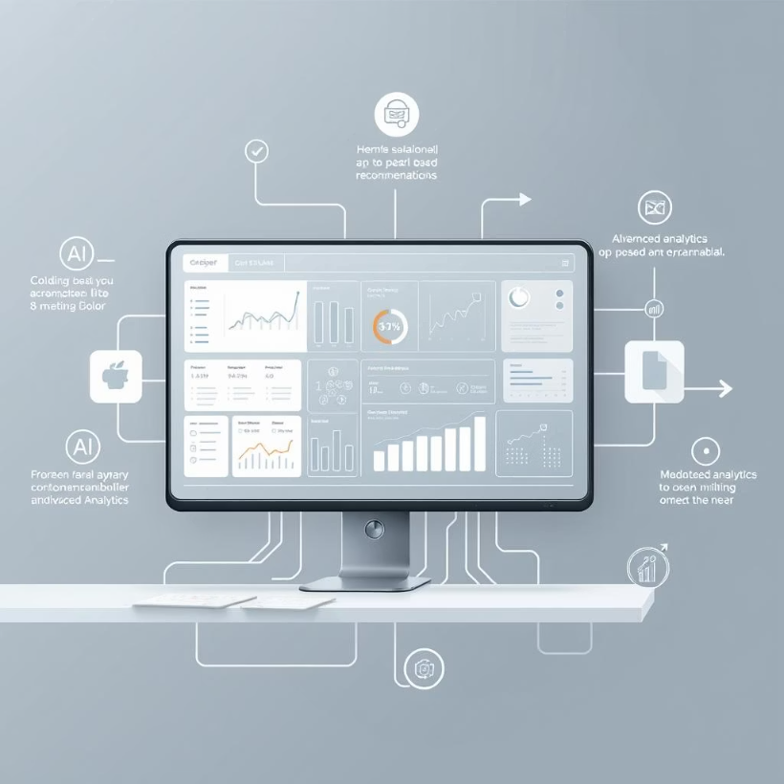
Summary & Vision
Future enhancements (mobile app, AI-based recommendations, analytics)
Scalability and flexibility of the system

